Slide 1
创建 uni-app Android 原生插件
以
HBuilderX 2.6.1.20200226
Android-SDK@2.6.1.74103_20200226
Android Studio 3.6.1
为例

Slide 2
1. 新建 Android uni-app 插件 Module

Slide 3
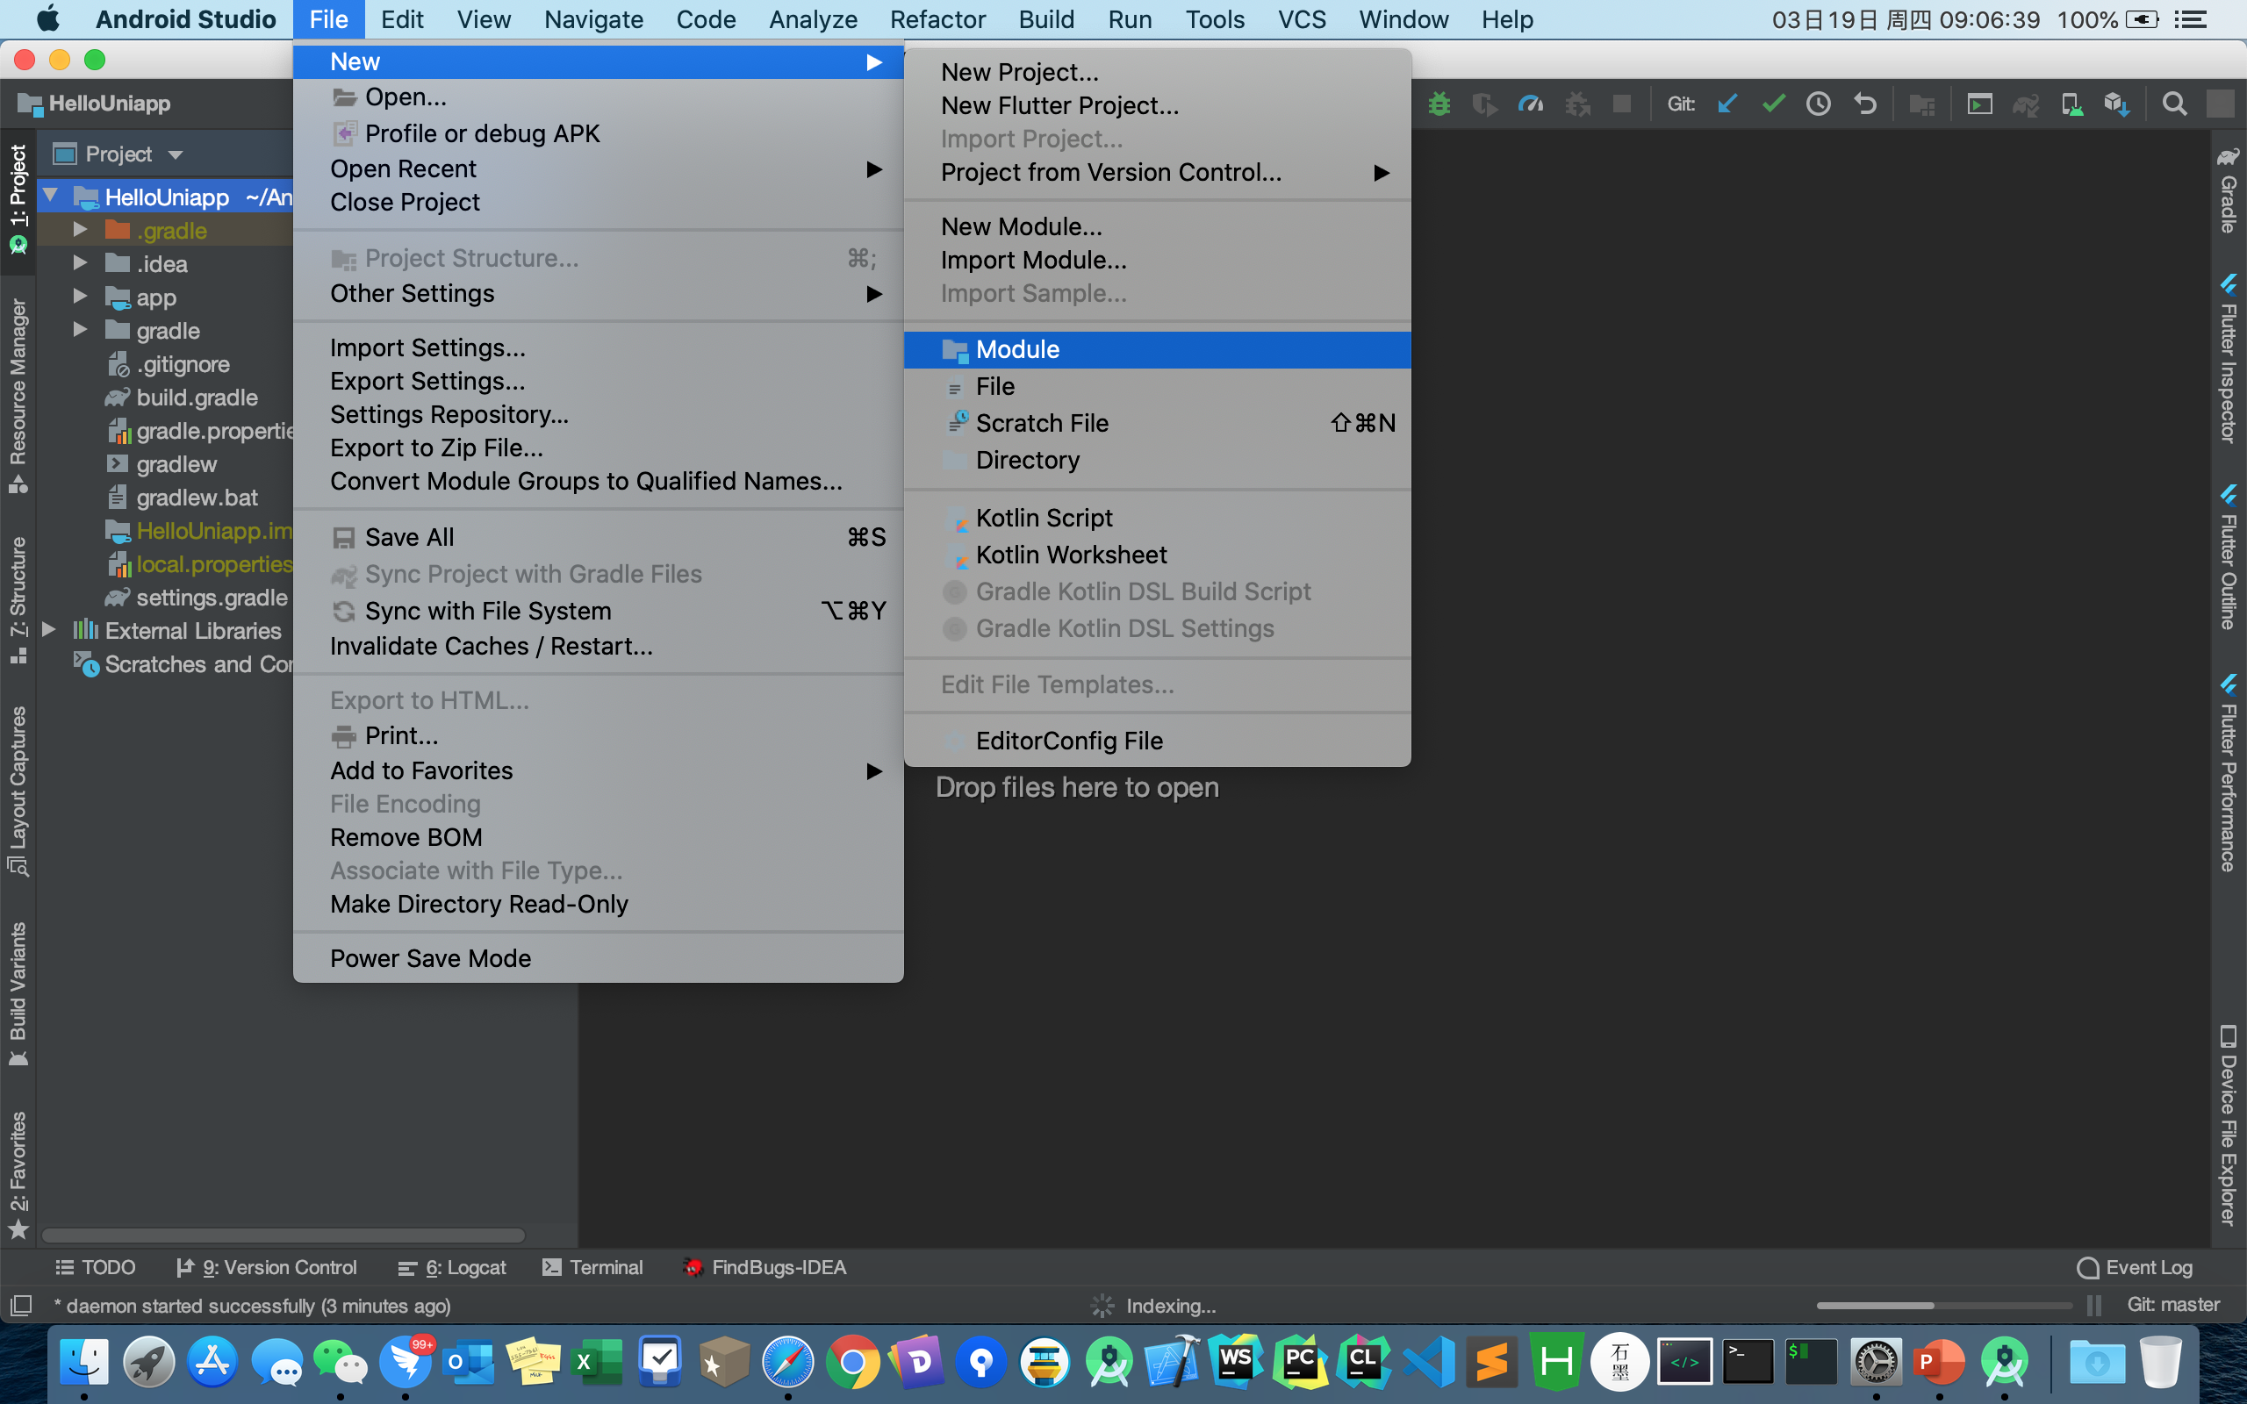

Slide 4
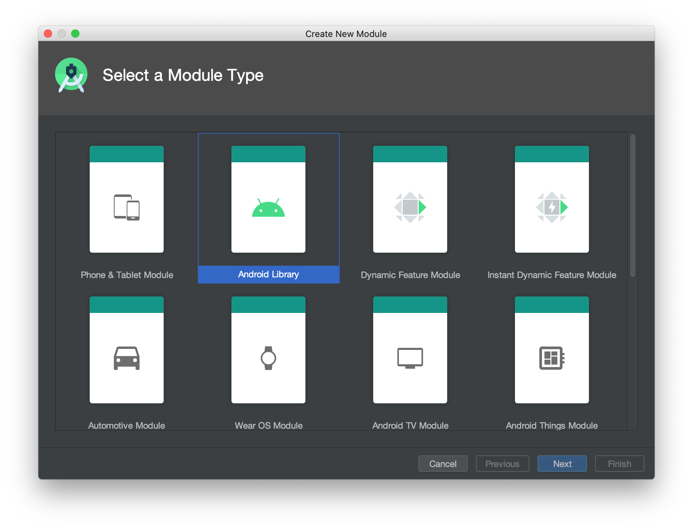
1
2

Slide 5
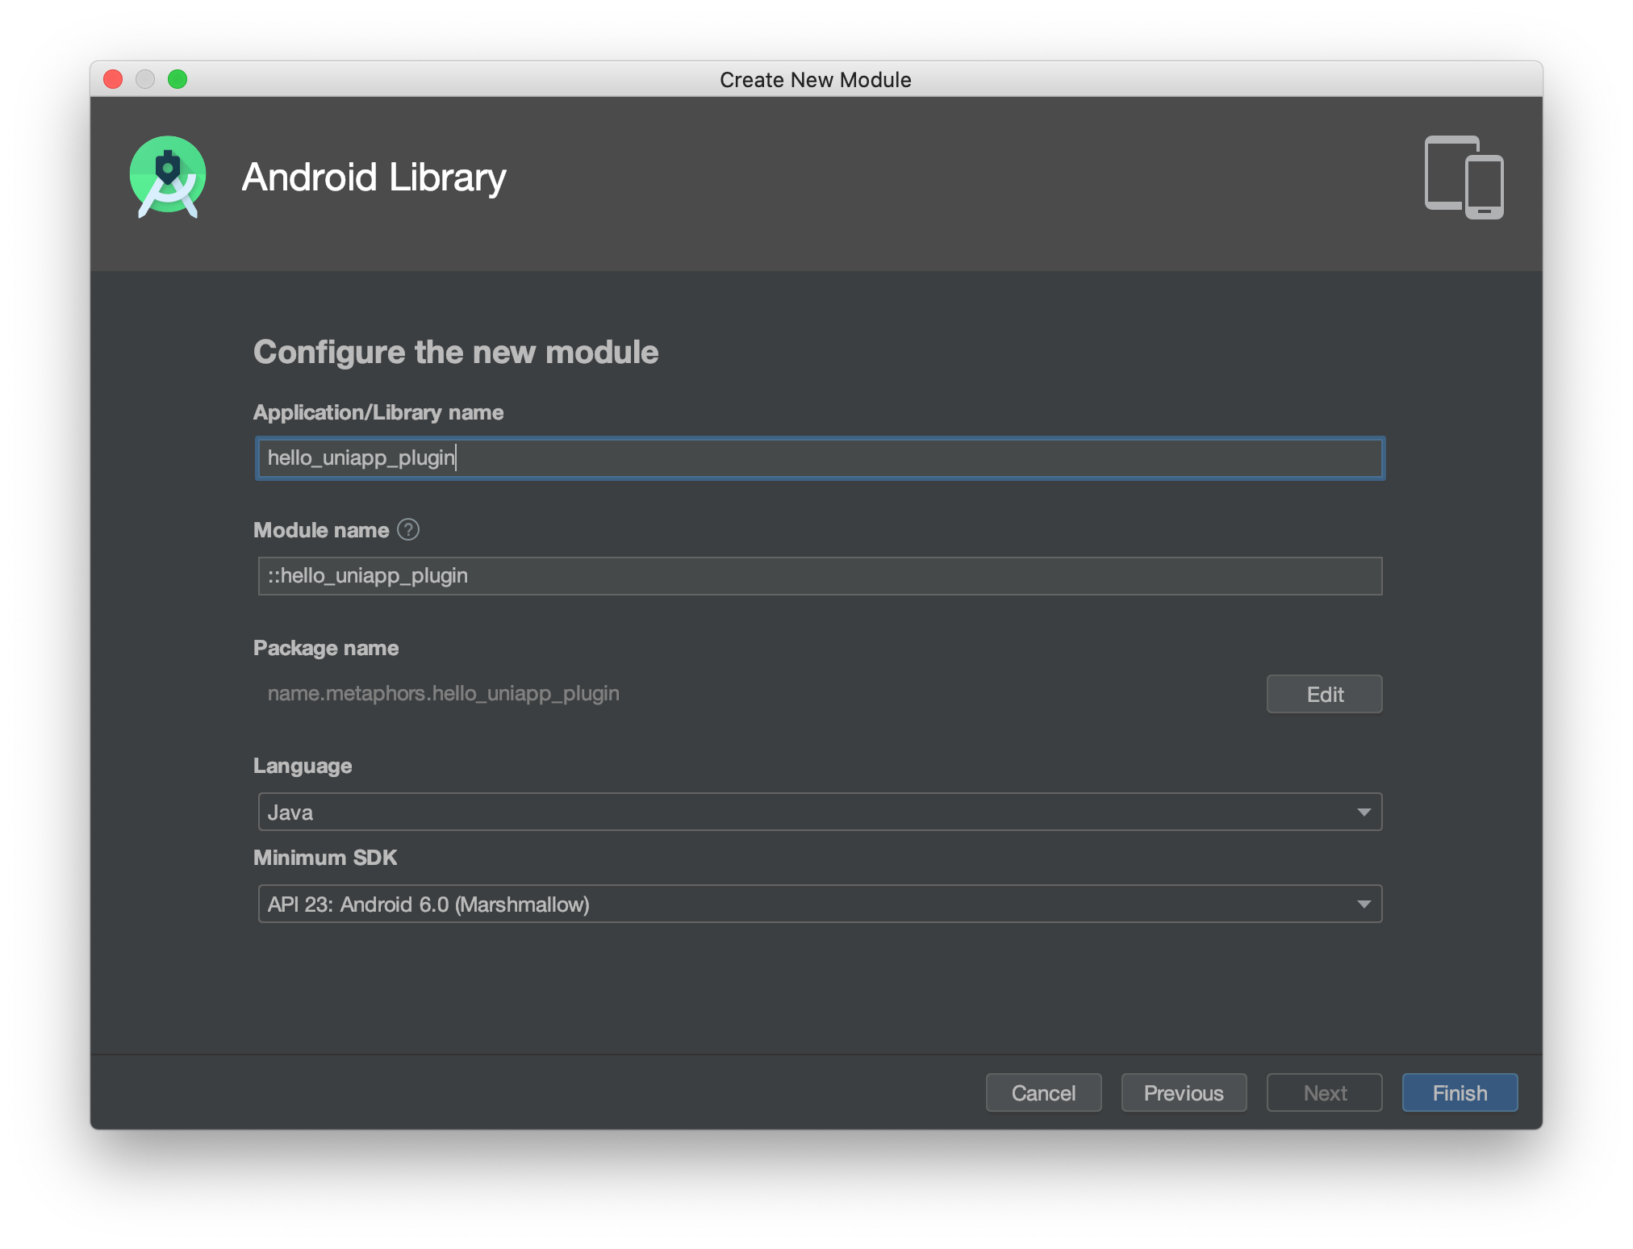
1
2
3
4
5
6

Slide 6
2. 删除不必要的文件
插件/src/androidTest
插件/src/test

Slide 7
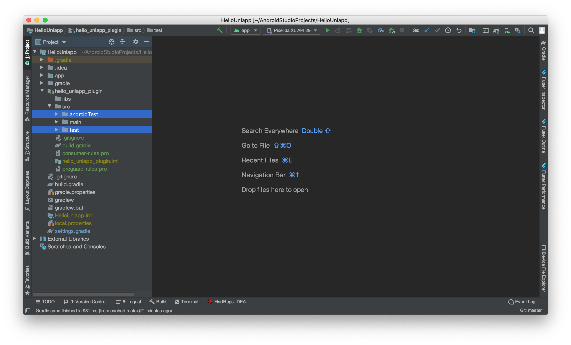

Slide 8
3. 修改插件下 build.gradle 文件

Slide 9
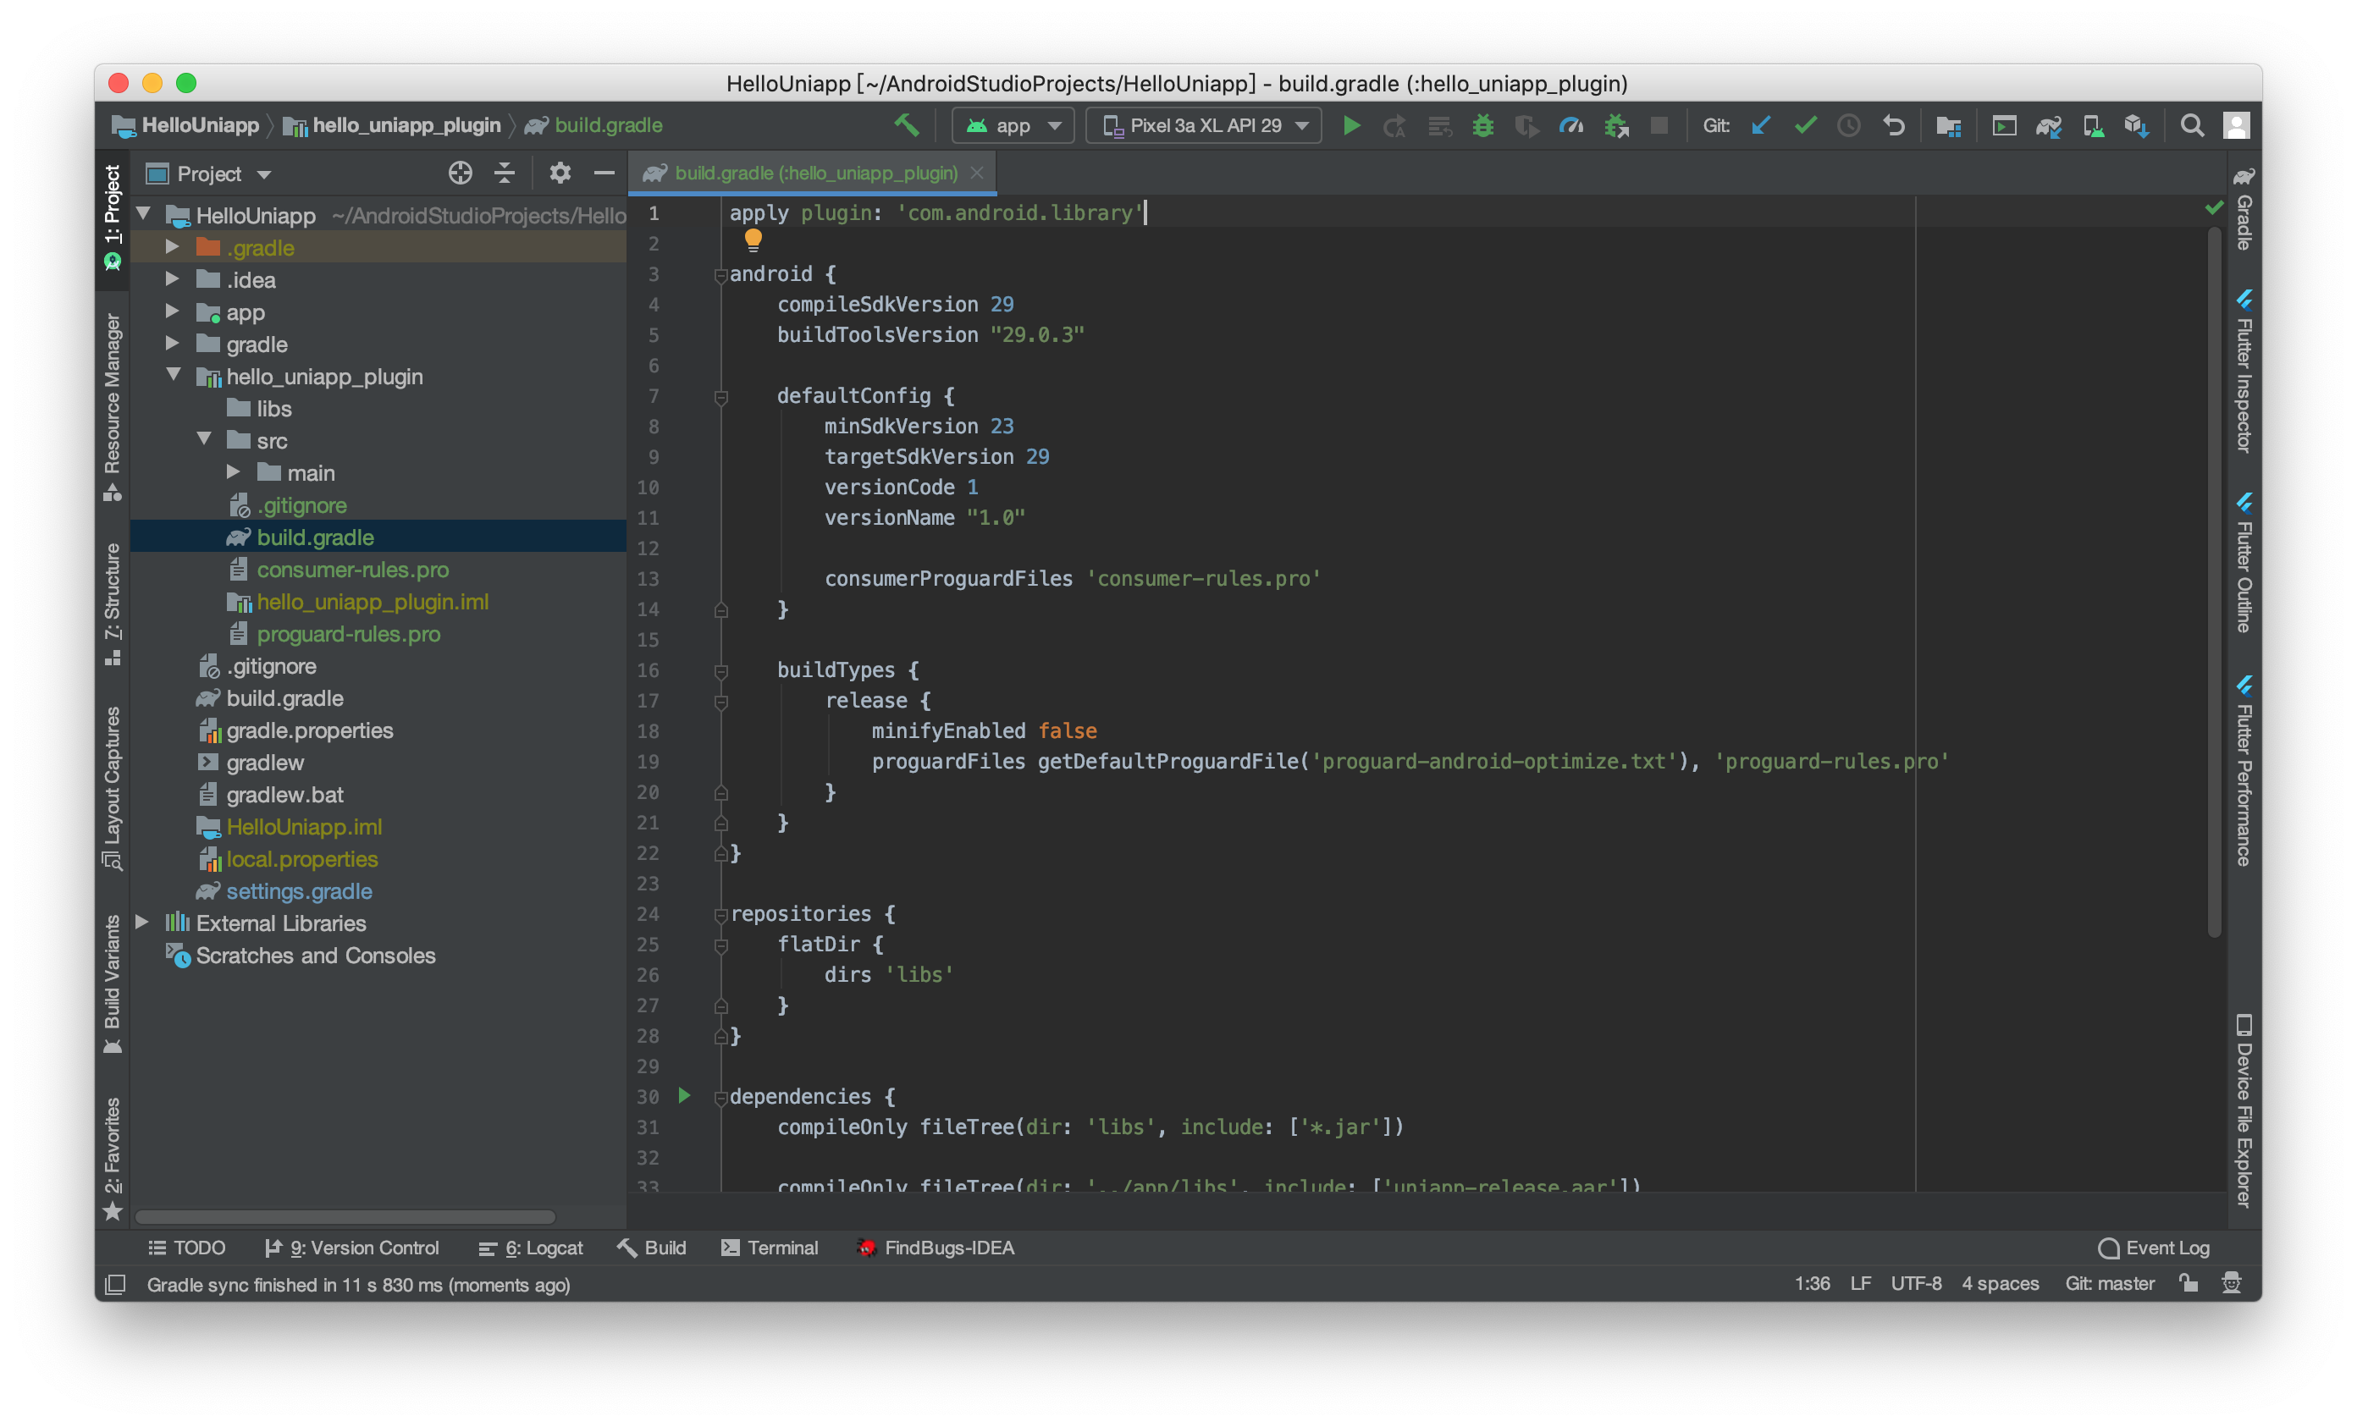
Notes:
apply plugin: 'com.android.library' android { compileSdkVersion 29 buildToolsVersion "29.0.3" defaultConfig { minSdkVersion 23 targetSdkVersion 29 versionCode 1 versionName "1.0" consumerProguardFiles 'consumer-rules.pro' } buildTypes { release { minifyEnabled false proguardFiles getDefaultProguardFile('proguard-android-optimize.txt'), 'proguard-rules.pro' } } } repositories { flatDir { dirs 'libs' } } dependencies { compileOnly fileTree(dir: 'libs', include: ['*.jar']) compileOnly fileTree(dir: '../app/libs', include: ['uniapp-release.aar']) compileOnly 'androidx.legacy:legacy-support-v4:1.0.0' compileOnly 'androidx.recyclerview:recyclerview:1.1.0' compileOnly 'androidx.appcompat:appcompat:1.1.0' }

Slide 10
4. 新建 XXWXModule.java、XXAppHookProxy.java

Slide 11
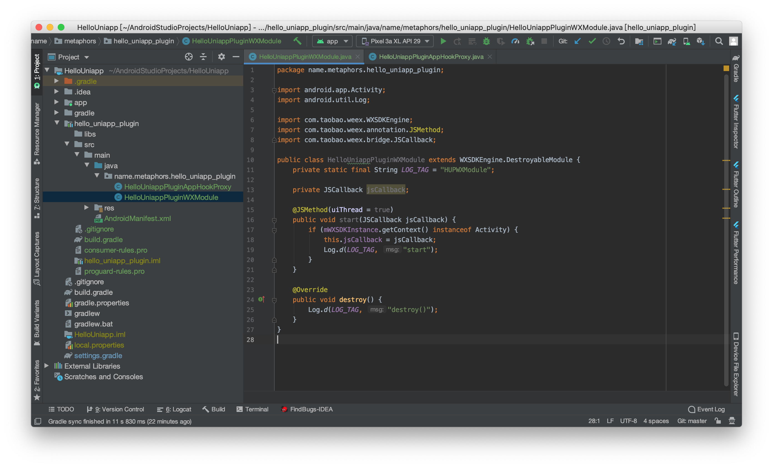
Notes:
package name.metaphors.hello_uniapp_plugin; import android.app.Activity; import android.util.Log; import com.taobao.weex.WXSDKEngine; import com.taobao.weex.annotation.JSMethod; import com.taobao.weex.bridge.JSCallback; public class HelloUniappPluginWXModule extends WXSDKEngine.DestroyableModule { private static final String LOG_TAG = "HUPWXModule"; private JSCallback jsCallback; @JSMethod(uiThread = true) public void start(JSCallback jsCallback) { if (mWXSDKInstance.getContext() instanceof Activity) { this.jsCallback = jsCallback; Log.d(LOG_TAG, "start"); } } @Override public void destroy() { Log.d(LOG_TAG, "destroy()"); } }

Slide 12
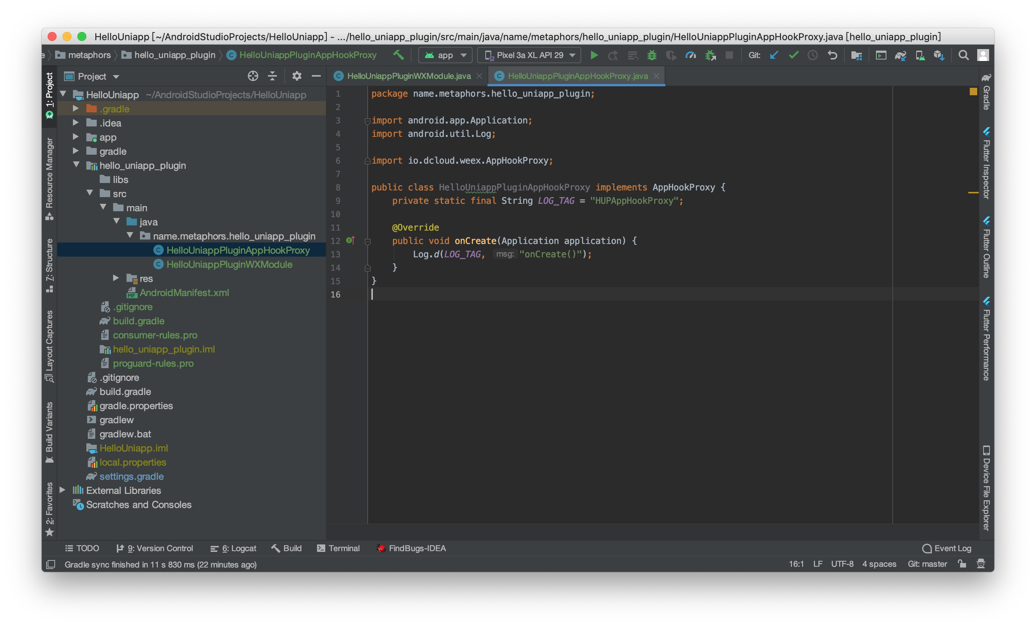
Notes:
package name.metaphors.hello_uniapp_plugin; import android.app.Application; import android.util.Log; import io.dcloud.weex.AppHookProxy; public class HelloUniappPluginAppHookProxy implements AppHookProxy { private static final String LOG_TAG = "HUPAppHookProxy"; @Override public void onCreate(Application application) { Log.d(LOG_TAG, "onCreate()"); } }

Slide 13
5. 新建 dcloud_uniplugins.json

Slide 14
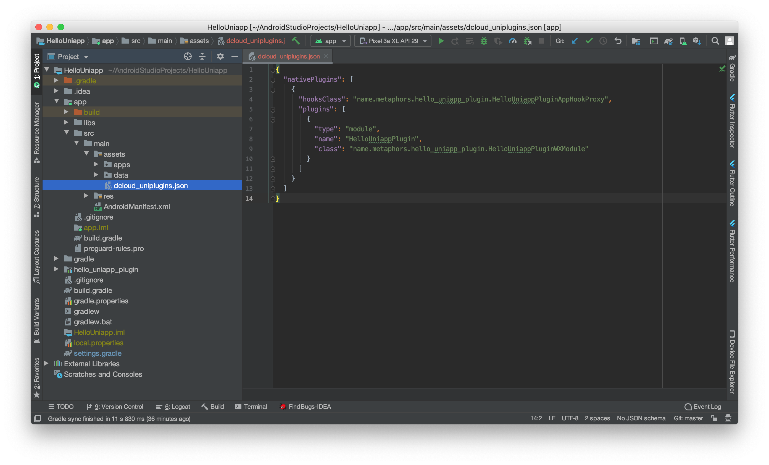
Notes:
{ "nativePlugins": [ { "hooksClass": "name.metaphors.hello_uniapp_plugin.HelloUniappPluginAppHookProxy", "plugins": [ { "type": "module", "name": "HelloUniappPlugin", "class": "name.metaphors.hello_uniapp_plugin.HelloUniappPluginWXModule" } ] } ] }

Slide 15
6. 修改 app 下 build.gradle 文件

Slide 16
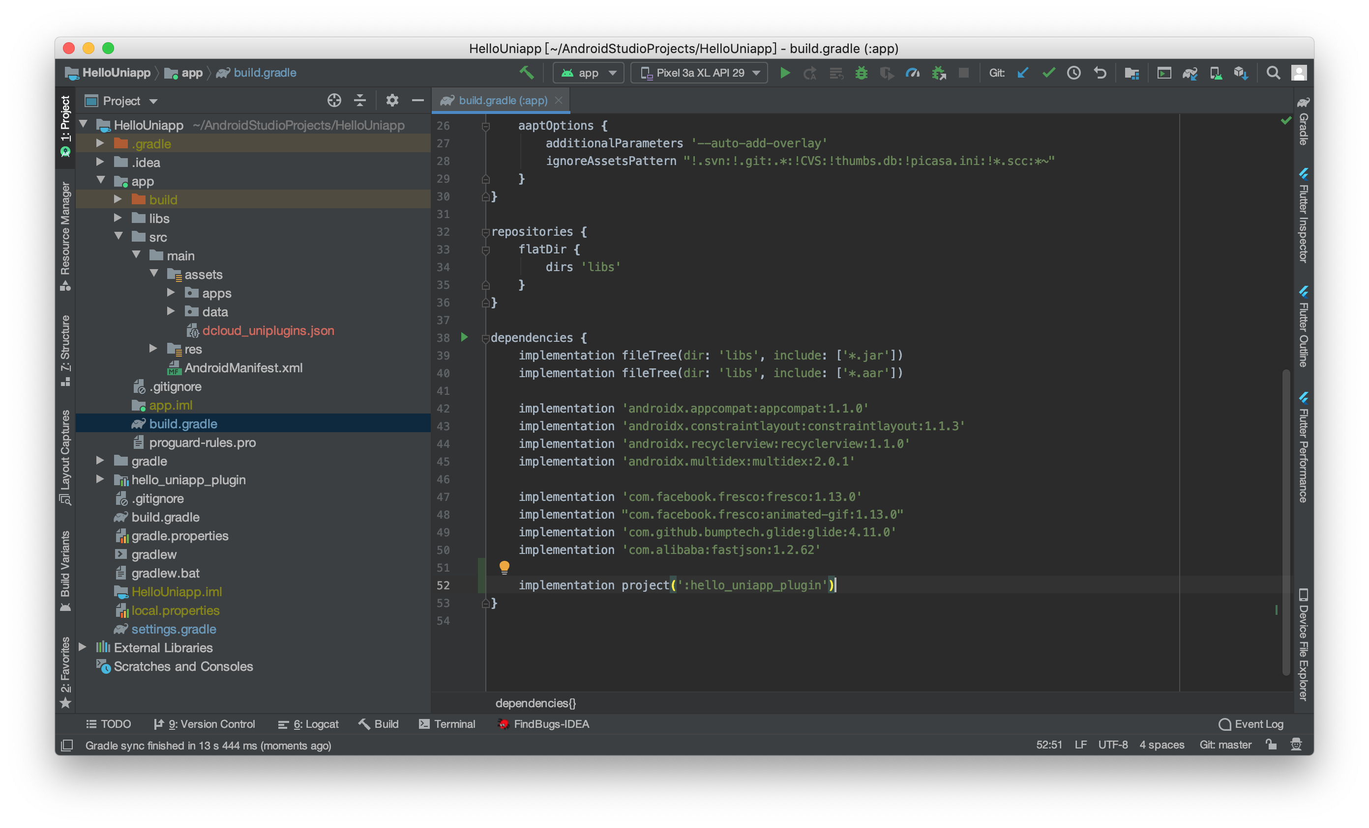
Notes:
implementation project(':hello_uniapp_plugin')

Slide 17
7. uni-app 工程调用 Android 原生插件
=>生成本地打包 App 资源放入 Android 工程

Slide 18
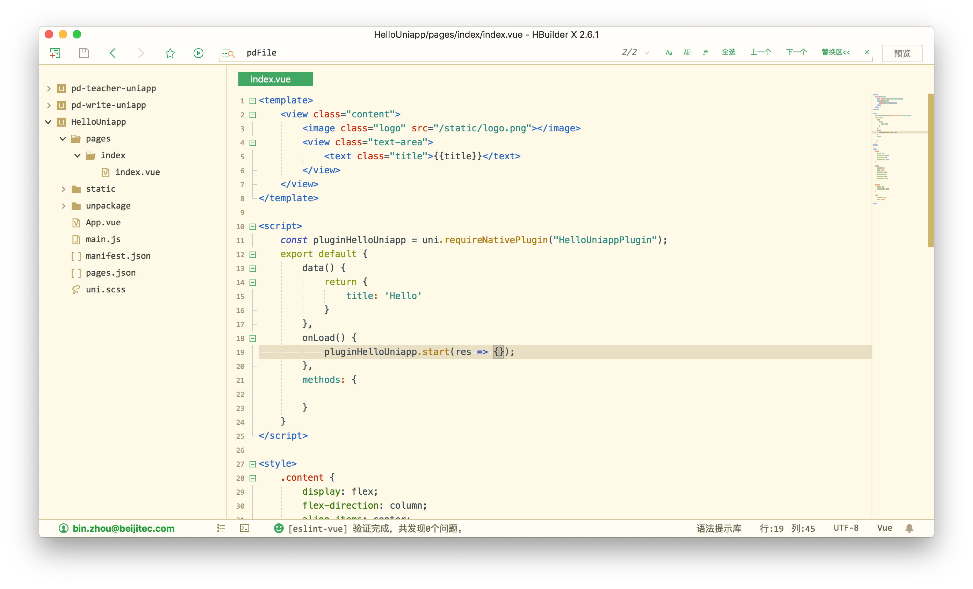
Notes:
const pluginHelloUniapp = uni.requireNativePlugin("HelloUniappPlugin");
﻿pluginHelloUniapp.start(res => {});

Slide 19
9. 调试运行，调用成功

Slide 20
